Slide 1

UBER ALGORITHMS ANALYSIS
Om Prakash (2019MCS 2567)
Kishore Yadav (2019MCS 2656)
SIL 861 - UBER Algorithm Analysis
Notes:
<number>

Slide 2
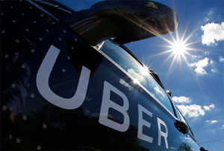
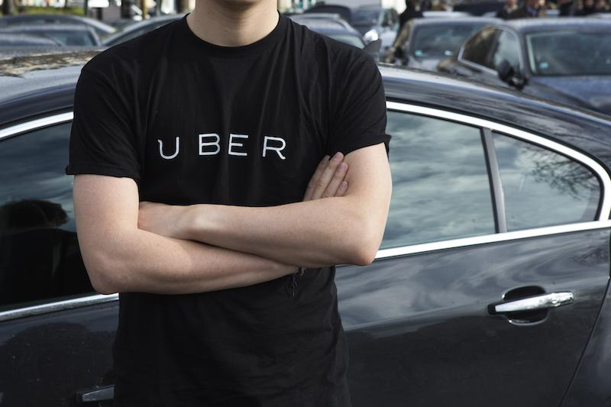
INTRODUCTION
SIL 861 - UBER Algorithm Analysis
<number>

Slide 3
COMPANY BACKGROUND
Uber thrives in
“gig” or "platform economy”
Founded in 2009
Founders: Garrett Camp and Travis Kalanick
Based in San Francisco
Originally a private car service for executives
Communication through emails and codes
Use technology to bring together passengers and drivers.
SIL 861 - UBER Algorithm Analysis
<number>

Slide 4
SCOPE
Study and analyzes ethical issues in how Uber algorithm implements company policies and its flaws
SIL 861 - UBER Algorithm Analysis
<number>

Slide 5
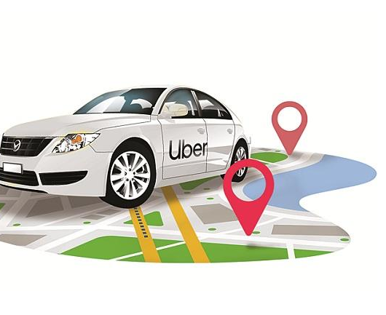
STAKEHOLDERS
Companies are increasingly using algorithms to manage their remote workforces. Called “algorithmic management”
Who can directly benefit?
Company (Uber)
Uber takes a cut for the platform it provides
Self-employed workers (Drivers)
Drivers earning improved manifold
Customers (Passengers)
Get a ride by tap
Other stakeholders
Government
SIL 861 - UBER Algorithm Analysis
<number>
Notes:
<number>

Slide 6
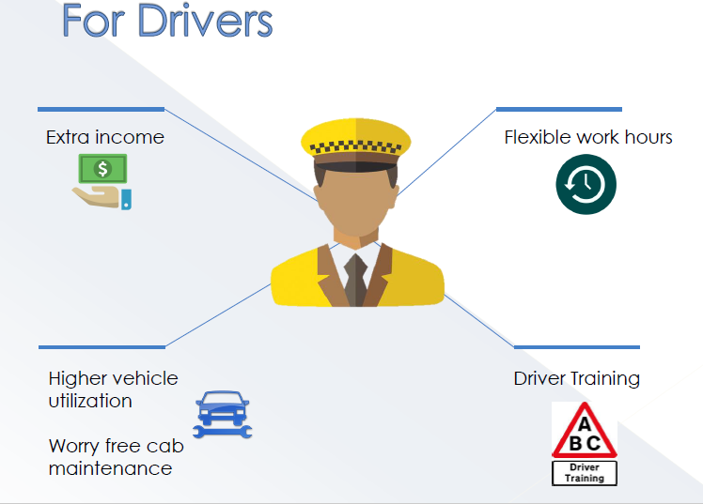
BENEFIT TO DRIVERS
SIL 861 - UBER Algorithm Analysis
<number>
Notes:
<number>

Slide 7
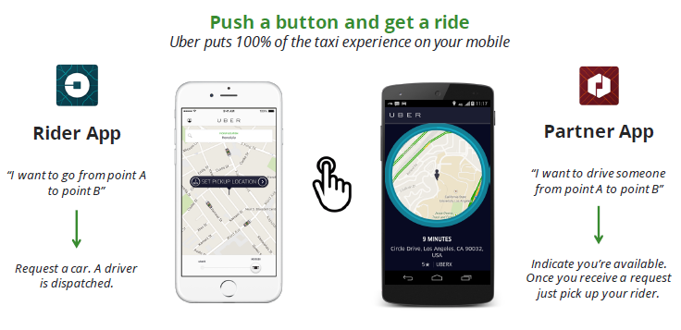
BENEFIT TO CUSTOMERS
SIL 861 - UBER Algorithm Analysis
<number>
Notes:
<number>

Slide 8
CURRENT SCENARIO
Drivers - independent contractors
solicits new ones
Promise of being your own boss
Reality of being an Uber contractor is different
Uber does control a lot of the ways that drivers behave on the job - Alex Rosenblat, a researcher at Data & Society
Drivers usually have to meet a human when they first sign up to drive
They interact with an automated management system primarily delivered by a mobile app
SIL 861 - UBER Algorithm Analysis
<number>
Notes:
<number>

Slide 9
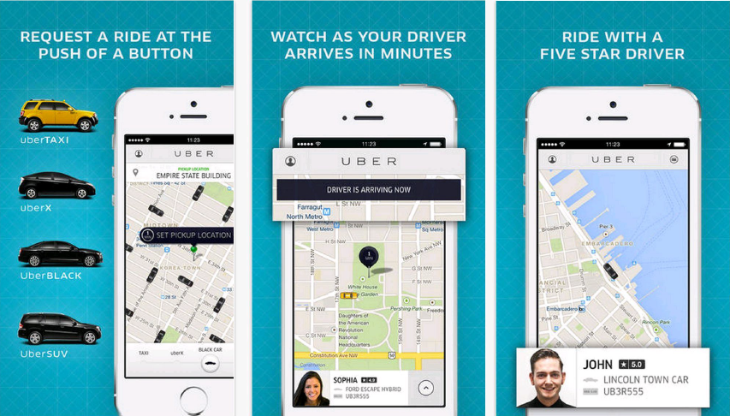
CURRENT SCENARIO ctd..
Proprietary algorithms match
Workers to customers (with the tap of a Smartphone)
Promising a seamless optimized transaction
SIL 861 - UBER Algorithm Analysis
<number>

Slide 10
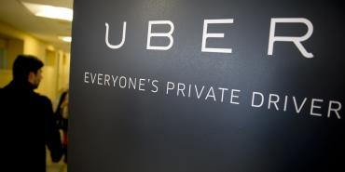
CURRENT SCENARIO ctd..
Uber- use machine learning algorithms
Smartphone apps that promise
Efficiency
Flexibility
Enormous information and power with UBER
Yet little-examined from legal perspective
Workers exploitation – immense
Remedies available to workers
As yet undeveloped
SIL 861 - UBER Algorithm Analysis
<number>

Slide 11
HOW ALGORITHM WORKS?
Optimizing a dispatch system using an AI simulation framework
At its core, Uber as a software platform currently has two main goals:
On the rider side, getting you a ride when you need it
On the driver side, maximize trips taken on the system, which maximizes our driver partners’ earnings
Getting a ride from an Uber driver is beautiful in its simplicity: simply open the app, set the pickup location, request a car, get picked up and pay with the tap of a button
Complex, non-linear, interacting systems
SIL 861 - UBER Algorithm Analysis
<number>
Notes:
<number>

Slide 12
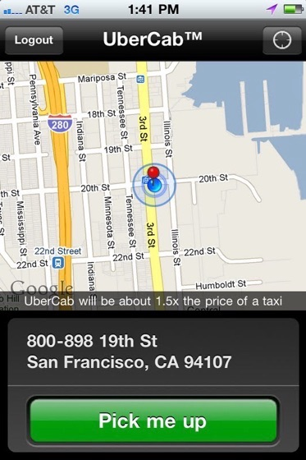
HOW ALGORITHM WORKS? MASSIVE DATABASE
Uses Data to Improve Their Service
There’s a great deal of data
being collected, produced and visualized behind the scenes
Massive database of drivers
Matches you with the driver closest to you
SIL 861 - UBER Algorithm Analysis
<number>
Notes:
<number>

Slide 13
HOW ALGORITHM WORKS?
Uber stores data for every trip taken
Even when the driver has no passengers
All of this data is stored and leveraged to predict
Supply and demand
Setting fares
Looks at how transportation is handled across cities and tries to adjust for bottlenecks
SIL 861 - UBER Algorithm Analysis
<number>
Notes:
<number>

Slide 14
HOW ALGORITHM WORKS? DATA ANALYSED
Uber also gathers data on its drivers
Non-identifiable information about their vehicle and their location
Monitors their speed and acceleration
All of this data is collected, crunched, analyzed and used to predict everything
Customer’s wait time
Recommending where drivers should place themselves via heatmap in order to take advantage of the best fares and most passengers
Implemented in real-time for both drivers and passengers alike
SIL 861 - UBER Algorithm Analysis
<number>
Notes:
<number>

Slide 15
HOW ALGORITHM WORKS? SURGE PRICING
Monitoring Supply and Demand
Surge pricing, a model nicknamed “Geosurge” at Uber
Crowded downtown space, be prepared to pay almost twice as much for it
Back in 2011, during New Year’s Eve in New York, a journey of one mile went from $37 to $135 over the course of the night
Customer backlash on rate-hiking is strong
Considered using machine-learning algorithms to predict where demand will be strong
In short term, surge pricing substantially affects the rate of demand
long-term use could be the key to retaining or losing customers
SIL 861 - UBER Algorithm Analysis
<number>
Notes:
<number>

Slide 16
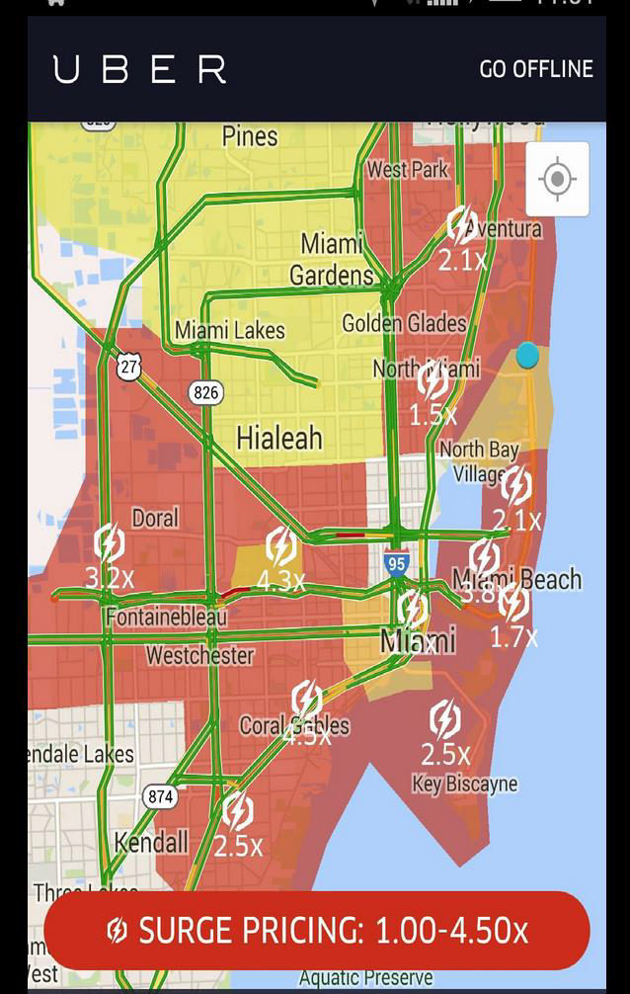
HOW ALGORITHM WORKS? SURGE PRICING
In order to get and maintain a strong customer and driver base, it needs to put data to work
Supply and demand data are not the same from city to city
Uber engineers devised a way to map the “pulse” of a city to connect drivers and riders more efficiently
SIL 861 - UBER Algorithm Analysis
<number>
Notes:
<number>

Slide 17
HOW ALGORITHM WORKS? VISUALIZING DATA ANALYTICS
Visualizing Data Analytics
Manages billions of GPS locations
Every minute, their platform juggles millions of events
Develop mapping and framework to data that the public (such as drivers) sees
Created a need for tools to be developed in-house
Visualizations
Surge pricing map
Route maps
Traffic map
Distributions of Uber drop-offs
SIL 861 - UBER Algorithm Analysis
<number>
Notes:
<number>

Slide 18
HOW ALGORITHM WORKS? UBER TRAFFIC
In big cities, where understanding the density of a given area may lead to dynamic pricing changes
Uber demonstrates this with a combination of layers that let them drill-down to see specific areas in more detail
SIL 861 - UBER Algorithm Analysis
<number>
Notes:
<number>

Slide 19
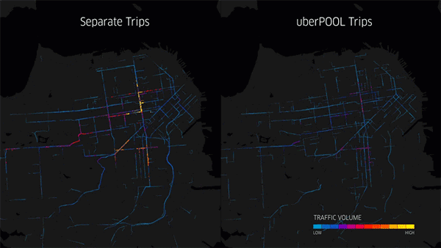
HOW ALGORITHM WORKS? UBER TRAFFIC
SIL 861 - UBER Algorithm Analysis
<number>
Notes:
<number>

Slide 20
ETHICAL ISSUES WITH UBER ALGORITHM
SIL 861 - UBER Algorithm Analysis
<number>

Slide 21
ALGORITHMS ISSUES
Uber drivers have the following major areas of concerns about working “for” algorithms
Steers its Drivers
Influence drivers decision making
Little transparency
Blind passenger acceptance
Surge pricing
Nudging by Uber
Constant surveillance
Driver Ratings
Surveillance
Dehumanization - CSRs “Uber’s robots”
SIL 861 - UBER Algorithm Analysis
<number>
Notes:
<number>

Slide 22
SURGE PRICING AND ALGORITHMIC LOGISTICS MANAGEMENT
Surge pricing zones is billed by Uber as a means to
Ensure positive customer experience
by enticing new supply to an area of high demand
Surge pricing is unreliable for drivers
Pricing is based on the passenger’s geo-location
Not the driver’s
Supply was no longer too low
The surge would disappear
Receive ride requests at a lower surge rate than displayed
passengers game the system by placing their pick-up location pin outside a surge zone
calling drivers to redirect them
SIL 861 - UBER Algorithm Analysis
<number>

Slide 23
“SOFT CONTROL” OVER DRIVER BEHAVIOUR
Uber’s institutionalized nudging of the driver includes
Heat maps
Incentives
Frequent messaging
Messages urging drivers to
Stay online, or to go online, imply or state explicitly that it will surge
SIL 861 - UBER Algorithm Analysis
<number>

Slide 24
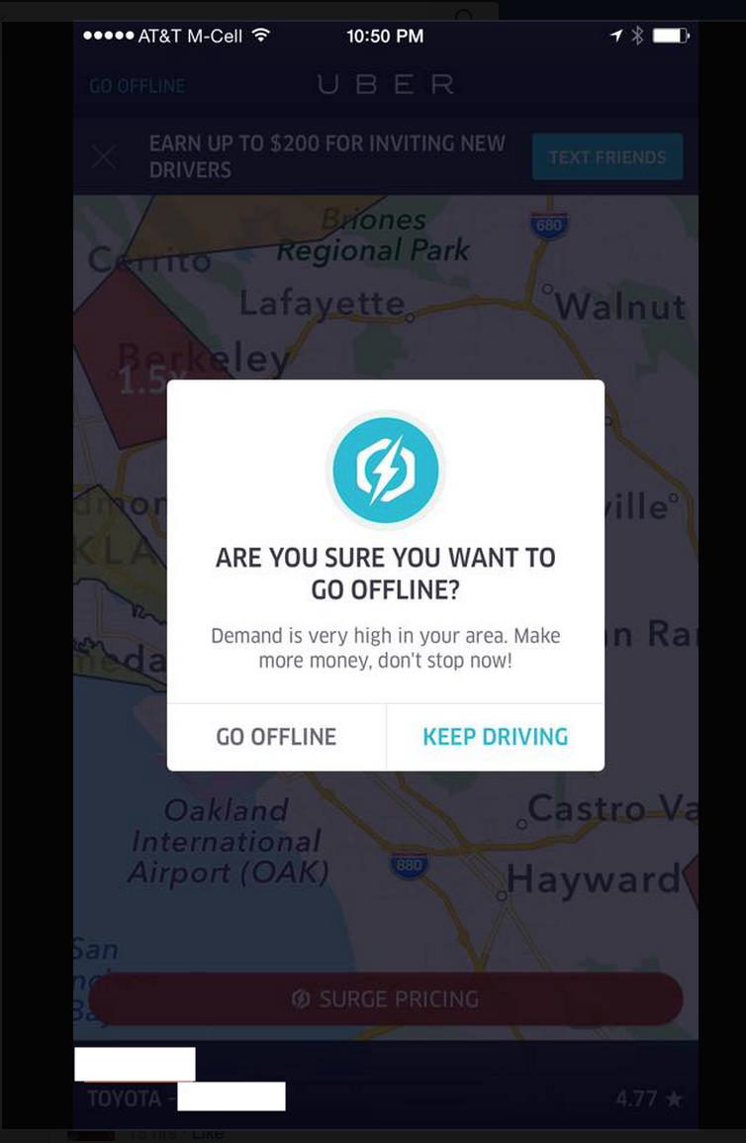
NUDGING BY UBER
Are you sure you want to go offline?
Demand is very high in your area
Make more money
Don’t stop now!
SIL 861 - UBER Algorithm Analysis
<number>

Slide 25
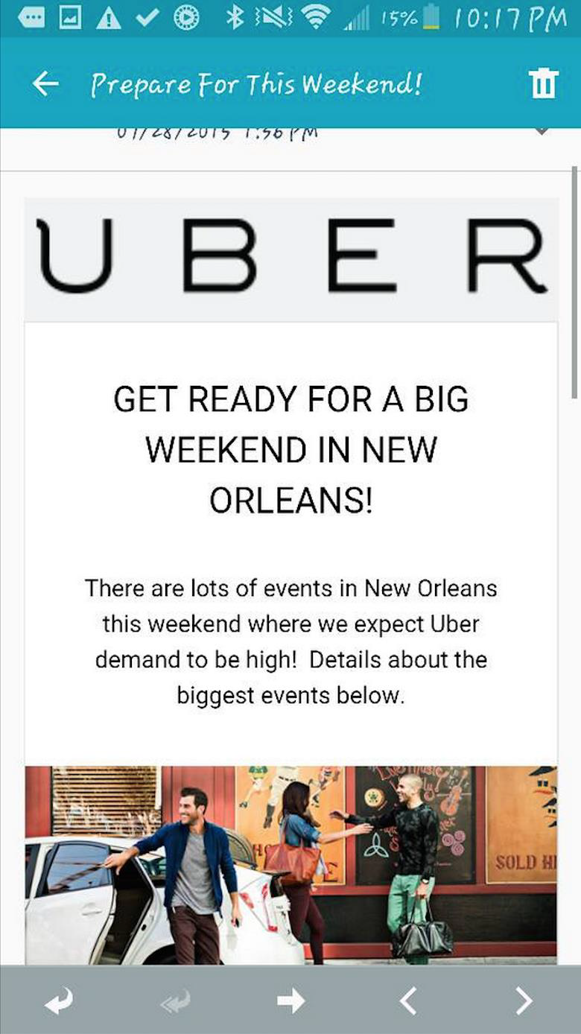
UNRELIABLE PREDICTIONS
Waiting in this surge for 30 min and not one ping!
When demand does not reflect Uber’s predictions
Drivers express frustration and distrust
CSR replied, We try to predict how busy it is going to be based on historical data
This is never going to be 100% accurate
SIL 861 - UBER Algorithm Analysis
<number>

Slide 26
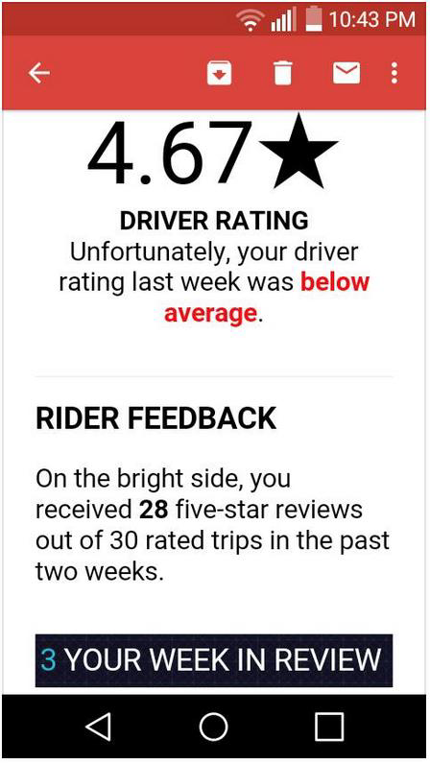
DRIVER RATINGS AND SURVEILLANCE
Driver rating system offered to riders, passengers are empowered to act as middle managers over drivers
Ratings directly impact drivers employment eligibility
To achieve good ratings, drivers must modify their behaviour to produce a homogenous Uber experience for riders
SIL 861 - UBER Algorithm Analysis
<number>

Slide 27
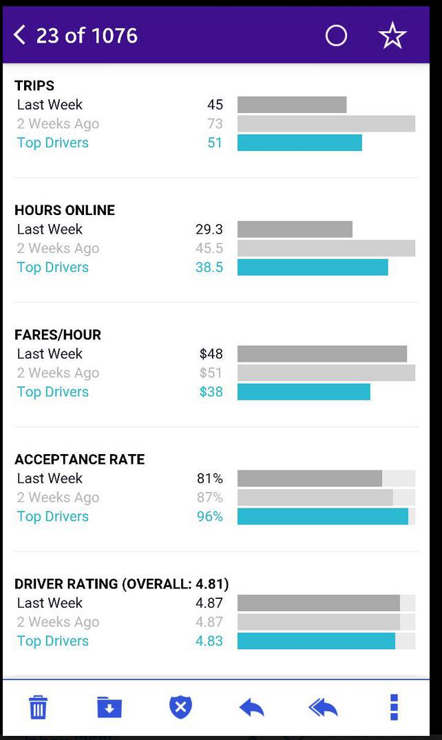
DRIVER RATINGS AND SURVEILLANCE
Uber controls how drivers behave through weekly performance metrics
Drivers must deliver a standardized service
SIL 861 - UBER Algorithm Analysis
<number>

Slide 28
FIRED BY THE ALGORITHM
Dehumanization – Customer Service Representatives(CSRs) “Uber’s robots”
When something does go wrong, we can’t tell the boss or a co-worker
Drivers can call or write to “community support” but the response is template based and lot of explanation is required to clarify and set things right
These CSR are trained they don’t use their understanding and their response is pre scripted
Fired by the algorithm because of a low rating or complaint from an angry passenger
SIL 861 - UBER Algorithm Analysis
<number>
Notes:
<number>

Slide 29
FIRED BY THE ALGORITHM ctd.
Fired by the algorithm — because of a low rating or complaint from an angry passenger
African-American driver told
That a passenger once called her “dumb” and “stupid,” using a racial epithet, so she ended the trip early.She wrote to a support rep to explain why and got what seemed like a robotic response: We’re sorry to hear about this. details
The rep offered not to match her with that same passenger again.
Disgusted, driver replied -“So that means the next person that picks him up he will do the same while the driver gets deactivated”
We appreciate you taking the time to contact us and share
SIL 861 - UBER Algorithm Analysis
<number>
Notes:
<number>

Slide 30
METHODOLOGY VERIFYING GROUND TRUTH
In order to verify the ground reality the study group took interviews of various drivers in and around Delhi area
Main object of the survey was to build a knowledge base about the problems faced by the drivers and study the ethical aspects related to them
Team took interviews of various drivers
Airport taxi stand
Noida streets
Drivers near GIP mall
Data from Uber driver forums from facebook and other social media
Driver interviews form YouTube
SIL 861 - UBER Algorithm Analysis
<number>

Slide 31
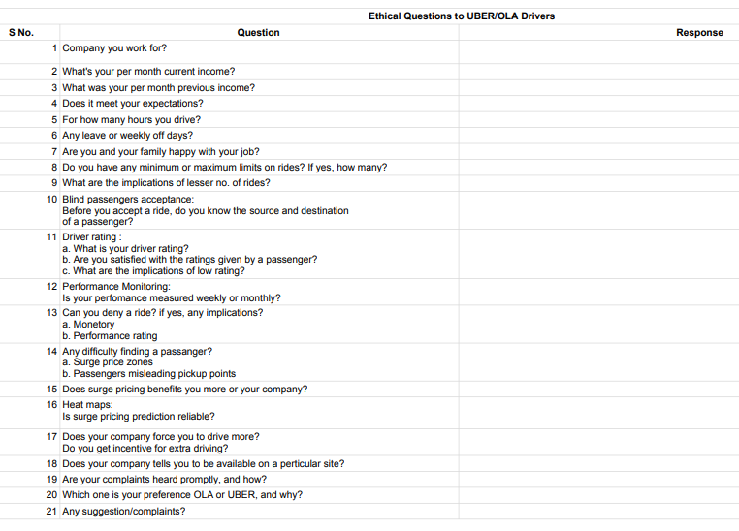
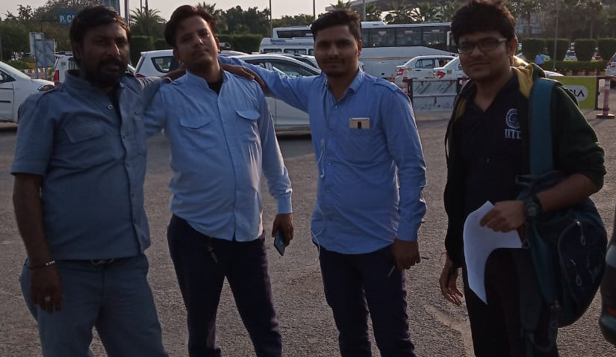
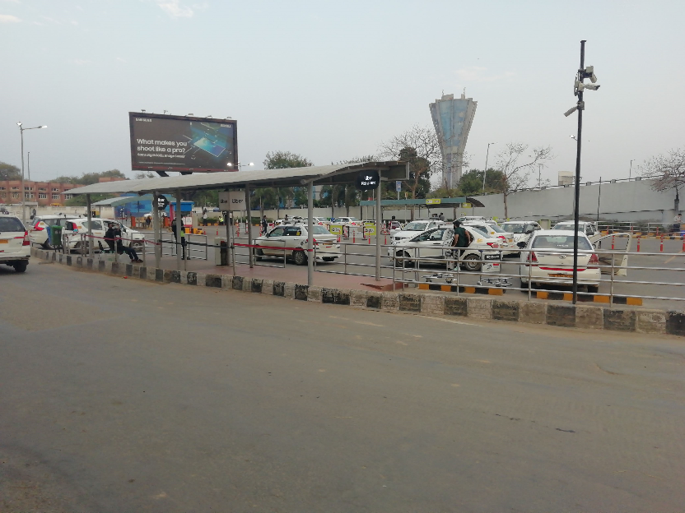
RESEARCH QUESTIONNAIRE
SIL 861 - UBER Algorithm Analysis
<number>
Notes:
<number>

Slide 32
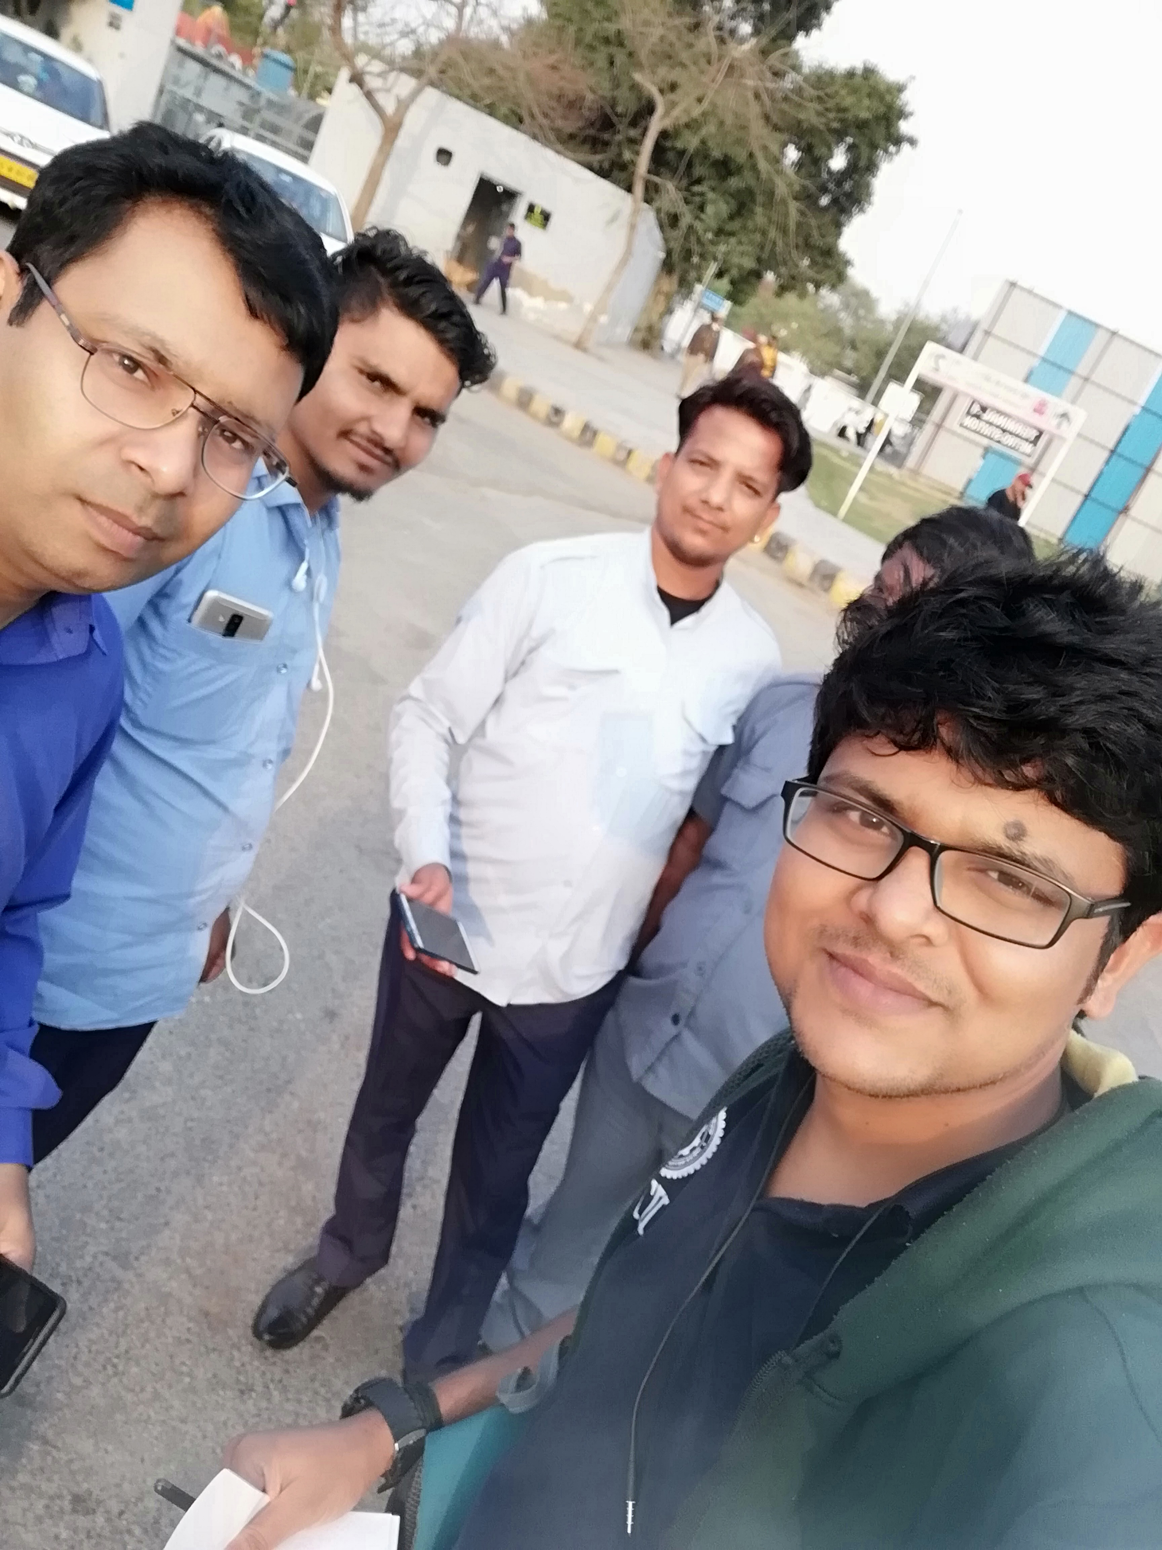
METHODOLOGY
Interview Ola and Uber drivers
Airport - IGI airport (done)
GIP Mall - Mall(done)
Random Drivers Street - Noida streets
No of drivers interviewed (28)
Ola taxi stand - 8 drivers
Uber taxi stand - 6 drivers
Independent taxi - 3 drivers
Employed Indigo - 1 driver
Gip Mall - 5 drivers
Sec 28 street - 3 drivers
Open source of information
News agencies
Social media forums
SIL 861 - UBER Algorithm Analysis
<number>
Notes:
<number>

Slide 33
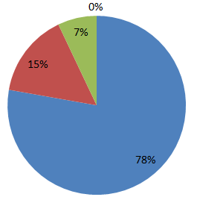

SURVEY DATA ANALYSIS EARNINGS INCREASED
Drivers asked: - Have your earning increased?
77 % of the drivers were happy that their earnings have increased, 15 % said it is more or less the same as the earnings increased with increase in working hours, so per hour practically they are actually earning are less than before but due to more working hours their earnings overall has increased. 8% drivers did not have clear idea so they refused to comment on it.
Deliberations:- Overall the earnings of the drivers have increased with increase in the no of working hours . Their job is now better organised and they are getting higher vehicle utilisation
SIL 861 - UBER Algorithm Analysis
<number>
Notes:
<number>

Slide 34
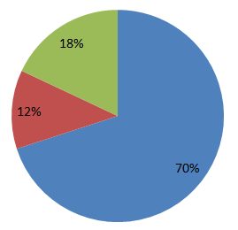
SURVEY DATA ANALYSIS COMPANY POLICY
Drivers asked: - Are you happy with the company policies.
70 % of drivers were not happy with the company policy. Whereas, 12% were happy and 18 % were not clear.
Deliberation :- It’s a general tendency that workers are not happy with company policy and can never be satisfied . However, they have willingly joined the company due to increase in their earnings. It is found that the education and understanding of the drivers is very limited so more or less it is the mob mentality that prevails.
It is Unethical that their drivers are not explained the company policies and drivers are exploited due to that.
SIL 861 - UBER Algorithm Analysis
<number>
Notes:
<number>

Slide 35
SURVEY DATA ANALYSIS SOFT CONTROL
Drivers asked: - Does Uber/Ola exercise soft control. If yes then how?
72% of drivers agree that cab companies exercise soft control and 28% had no Idea or are not aware. Companies exercise soft control through nudging via repetitive messaging which are lucrative in nature, these messages are sent when drivers try to go offline, when rush(demand) is high, but more or less they can expect these messages any time of day. The Idea of these messages is to keep drivers available most of time for duty.
Deliberation:- Movement of each and every driver on road is monitored via the smartphone application. Uber and Ola both exercises soft control on their drivers via numerous lucrative texts messages and make them work more at the companies’ choice of place. It is highly unethical on companies part to exercise soft control on drivers just to keep their profits high.
SIL 861 - UBER Algorithm Analysis
<number>

Slide 36
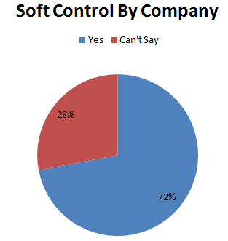
SURVEY DATA ANALYSIS SOFT CONTROL
SIL 861 - UBER Algorithm Analysis
<number>

Slide 37
SURVEY DATA ANALYSIS WORKING HOURS
Drivers asked :- Have your working hours increased in comparison to your previous job?
92 % drivers have agreed their working have increased. 8 % of drivers said it depends on them how much time they work.
Deliberation:- Sole aim of the drivers is to increase their income, this greed is exploited by the company to make them stay on job for longer time. Very less importance is given to driver’s health and safety aspects. This highly unethical on companies part to prologue the drivers working hours. This increases the frustration in drivers and lowers the safety aspects of the trip.
SIL 861 - UBER Algorithm Analysis
<number>

Slide 38
SURVEY DATA ANALYSIS EXPECTATIONS
Drivers asked: - Does this company meet your expectations?
42 % said yes and 58% say no. Initially the income was high and gradually it has reduced. Though, many drivers think that the income is still better when they compare it with free lance drivers. Many drivers have left the jobs due to dissatisfaction.
Deliberations:- Initially the companies per Km rate to drivers was high up to Rs 14 but now it has come down to as low as Rs 6-7per km in many cities, drivers had tried to protest against it but with very little success as the company is all mighty and there is no participation of workers in shaping the company policies.
SIL 861 - UBER Algorithm Analysis
<number>

Slide 39
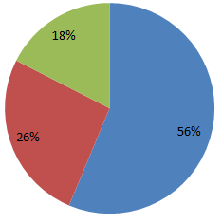
SURVEY DATA ANALYSIS COMPANY PREFERENCE
Driver asked :- Do you want to work for some other company or as a free lance driver ?
56 % drivers are working for both Ola and Uber, 26% are working for either Ola or Uber and 18% work as free lance drivers or for other company. Initially market share of Ola was very high but Uber gave more lucrative offers to the drivers in the form of incentives but after market capture the incentives perished
Deliberations:- Drivers want to work as employees for the companies and want to have a stable job, if given opportunity they will like to make a switch. It is unethical on company’s part to remotely control the lives of drivers and not considering them as employees.
Company Preference
SIL 861 - UBER Algorithm Analysis
<number>

Slide 40
SURVEY DATA ANALYSIS DISCRIMINATION
Drivers Asked:- Do you face any discrimination in Uber or Ola?
77 % drivers said Company drivers are given preference to accept the rides. How rest drivers are allocated rides the process is not clear. Many drivers are given more rides as compared to others, the reason for this discrimination is not clear to drivers.
Deliberations:- Company favours its drivers which are on its payroll. The job distribution is not fair this creates dissatisfaction among other drivers. The company should make the job allocation policy more transparent and educate drivers about it. This will keep the motivation of the drivers high.
SIL 861 - UBER Algorithm Analysis
<number>

Slide 41
SURVEY DATA ANALYSIS WAGE THEFT
Drivers Asked:- Do you get all money which is promised to you by the company or you experience any wage theft?
77% drivers are of the opinion that they are paid what charges are displayed at the end of the trip. Drivers are not aware how the rates are varied dynamically, especially how the surge pricing, companies cut are varied. Off late Uber takes Rs 30 as a tip from customers almost all drivers say this tip has never reached them, which is ethically wrong.
Deliberation:- It is ethically wrong on companies part not to forward the received tip to respective drivers. They need to educate drivers how this money is being used directly or indirectly for benefits of drivers, this is surely causing distrust in drivers and they feel cheated.
SIL 861 - UBER Algorithm Analysis
<number>

Slide 42
SURVEY DATA ANALYSIS INCENTIVES
Drivers Asked:- is there any incentive policy in the company that makes you earn more?
92% of drivers said there is incentive policy in company which has drastically reduced over years, 8% drivers were not aware. Driver’s complaint that initially around 2012 incentives were very high which made their earnings very high. Due to these lucrative earnings many drivers left their previous jobs and joined Ola/ Uber but gradually the incentives reduced and non there is very little to nil incentives.
Deliberations:- Drivers express sorrow and distrusts due to the varying nature of the company policy. They feel that drivers should be part of company’s decision making and planning. This is only possible through collectives and cooperative or some form of driver unions, but as the drivers are not considered as employees they cannot have trade unions recognised by government.
SIL 861 - UBER Algorithm Analysis
<number>

Slide 43
SURVEY DATA ANALYSIS
Drivers Asked:- Drivers were asked if their problems, complain are heard and resolved.
85% of drivers said that there complaints are not heard or acted upon. They feel that company highly favours the customers over drivers even if customers are wrong to some extent. However, 12% drivers said they are satisfied with the company, company offices of Ola and Uber are spread across Delhi and NCR and if they face any major problem they can get it resolved there. 3% drivers had no clue about this as they were new in this field.
Deliberations:- Drivers are penalised for false complains by the customers. Whenever there is a serious complaint against a driver, his service is immediately suspended pending further investigation, and during that time, his earnings take a hit. To clarify on such issues drivers have to go to the company offices and explain their side. Most of the time decision goes in favour of customers but if driver is able to clarify then his pay and work is restored.
SIL 861 - UBER Algorithm Analysis
<number>

Slide 44
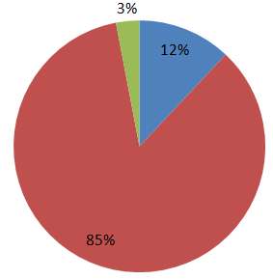
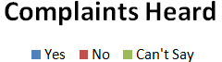
SURVEY DATA ANALYSIS
Deliberations continued:- In India cabs don’t have front and dashboard cameras, so it becomes difficult to judge who is right driver or customer. Uber and Ola have taken a note of this and are trying to find remedies how to resolve these issues.
In India unlike other countries the drivers get to interact with office staff at company offices. It can be said that their problems are heard to some extent.
SIL 861 - UBER Algorithm Analysis
<number>

Slide 45
FINDINGS & ETHICAL ISSUES
Prior jobs
Most driver were doing low income jobs(crane operator, delivery boy, security guard) or were a freelance driver soliciting passengers on their own
Driver earnings prior to joining cab companies were 10k – 18k
Increased Earning- Cab companies have organised their job and passengers soliciting has become online through Smartphone apps. More passengers means increased vehicle utilisation thus, more earning
Prolong Working Hours
Sole aim of Cab companies is to increase earnings giving little botheration to drivers physical and mental health
They Make drivers work for 12 to 18 hours a day by luring them with surge pricing and frequent nudges
SIL 861 - UBER Algorithm Analysis
<number>
Notes:
<number>

Slide 46
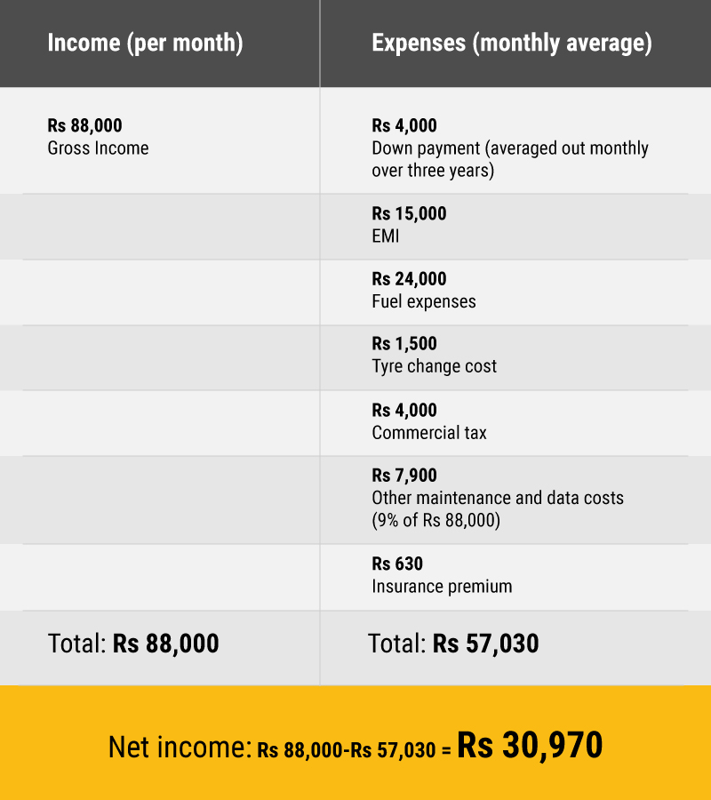
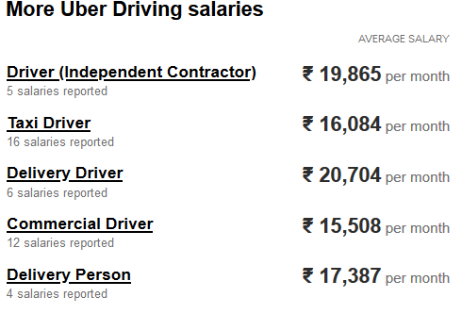
FINDINGS & ETHICAL ISSUES
Driver earnings
“To make more than 90k a month, you have to work 20 hours a day, which means you can’t go home, sleep properly or have a normal life” — Uber driver Abhijeet Singh
SIL 861 - UBER Algorithm Analysis
<number>

Slide 47
FINDINGS & ETHICAL ISSUES
Drivers work for both Ola and Uber to maximise their vehicle utilisation
Its unethical to call drivers employees in this context as the burden of employment should not be forced on one company
Drivers work for multiple companies because their earnings are not fixed or stable
if option given drivers will prefer employment over freelance job
Driver come from less educated background (<10th pass) and understanding Uber or Ola business model is difficult for them
There is lack of understanding of working mechanism
Legal issues and driver rights have to be addressed as it seams they have no rights
SIL 861 - UBER Algorithm Analysis
<number>

Slide 48
FINDINGS & ETHICAL ISSUES
Drivers are not clear on how company deducts charges
Uber takes 25 % whereas Ola varies from 20 to 35 %. Terms of engagement should be clearly laid down
“They used to charge 5% two-and-a-half years back(in 2014), then it was 10% and now we are paying 25% commission for the last year-and-a-half. I am not able to service my personal loan for the vehicle and plan to go back to a private taxi contractor”
Unethical Wage Theft
The Cab company cut is not fixed and many times the Drivers are penalised more, this is absolutely unethical and can be termed as wage theft
Tip from customers- Old off lte due to covid-19 charges Rs 30/- to customers as tip for drivers but the amount never reaches drivers
Unethical Market capture Strategy
Before 2012 the earning of drivers were very high after 2017 earnings have drastically reduced
Incentives – Initially high incentives were offered
“When Uber and Ola came to India first, they assured drivers something like Rs100,000-150,000 per month. But now, drivers are earning just Rs20,000 every month, of which Rs5,000-10,000 goes for EMI,” said Tanveer Pasha, president of Ola, Taxiforsure and Uber drivers and owners association
<number>

Slide 49
FINDINGS & ETHICAL ISSUES
Sarvoday Driver Welfare Association, a Delhi-based union of drivers
Demanded the cab-hailing firms significantly increase fares from Rs6 per km and reduce their commission rates of 25% per ride
A company spokesperson said
“driver earnings across India have largely remained sustainable and consistent over the last several months” and over 80% of drivers who are online for eight hours a day make between Rs1,500-Rs2,500 net after deducting 20% service fee- contrary to drivers claims of higher cut by company
Not taking Onus is Unethical
If any mishap happens the company disowns the driver
Delete the record of driver
Company talk about insurance but no one gets claim
If some accident happens while driver trying to reach a surge area as directed company will disown the driver . They promise 5 lakh support to diseased family but it is never offered .
SIL 861 - UBER Algorithm Analysis
<number>

Slide 50
FINDINGS & ETHICAL ISSUES
Surge and Boost pricing concepts prevail both in India and abroad. Surge pricing benefits company more than it benefits drivers.
Surge pricing dynamically change based on demand and supply. Cab companies can create high demand at a place
Drivers are often paid less than actual surge rates
Boost pricing benefits driver directly
Offered during special timings like from 1800hrs to morning 0500 hrs at IGI airport
Boost stays for longer duration and is predictable
Boost pricing is similar to extra charges freelance drivers take during late night hours
SIL 861 - UBER Algorithm Analysis
<number>
Notes:
<number>

Slide 51
FINDINGS & ETHICAL ISSUES
Governments not taking regulatory control- The government is planning to cap surge pricing by app based taxi aggregators to 3X the base fare
Cap on surge pricing results in lower driver earnings. Uber Drivers in Bengaluru on average earn 8-15% lower than in Hyderabad, and drivers took home 22-25% less due to higher cost of operation in Bengaluru
Government either state or central should give adequate guidelines for these companies to operate
This will increase satisfaction level among drivers
At the same time the profit margin of drivers should not reduce
Drivers in India have Welfare Association but they have no legal connotation like unions
SIL 861 - UBER Algorithm Analysis
<number>

Slide 52
FINDINGS & ETHICAL ISSUES
Driver also rate customers
Passenger ratings are a way for Uber to protect its drivers
If customer rating is low customers are not matched to same driver
To break effect, customer can book through others mobile or use new sim card
No proper mechanism to report problem
Drivers generally deal with Customer Service Representative (CSR)
Template response
India situation is bit better due to multiple office
If drivers are off-road | deactivated they have to report to office
Off-road drivers could be for some hours and after elapse of that driver resumes service
Rules are heavily in favour of customers and driver have very little say
SIL 861 - UBER Algorithm Analysis
<number>

Slide 53
FINDINGS & ETHICAL ISSUES
Blind passenger acceptance is unethical – if drivers are their own boss then they should not be penalised for refusal of rides
Local rides drivers view destination only after receiving OTP from
passenger
Out station rides – Driver knows the destination city but not which
part of city
Drivers are not penalised for refusing out station rides but are penalised for refusing local rides
High Driver rating
Drivers are encouraged to keep ratings high – customers act as managers
Not right to be judged by unknown and frequently changing managers
Above 8.2 /10 for Ola and 4.9/5 for Uber- Higher rating more likely to get ride (if more drivers near)
SIL 861 - UBER Algorithm Analysis
<number>

Slide 54
FINDINGS & ETHICAL ISSUES
Performance feedback is given in both Ola and Uber
Weekly performance feedback is given in Ola and not in Uber
Uber drivers can monitor their ratings through app
Performance review is done only through App based on driver ratings and not in person
Drivers are judged by multiple managers (passengers) who are totally disassociated with driver before and after ride ends
Not much a driver can do to complain for lower ratings as the judgement is mostly in favour of passenger
Company owned vehicles get more rides(80% for Ola
50% for Uber)
Drivers can work for company owned vehicles- in that case about 1500 per day cut has to be given to company. Drivers prefer their own vehicle as earnings are higher.
SIL 861 - UBER Algorithm Analysis
<number>

Slide 55
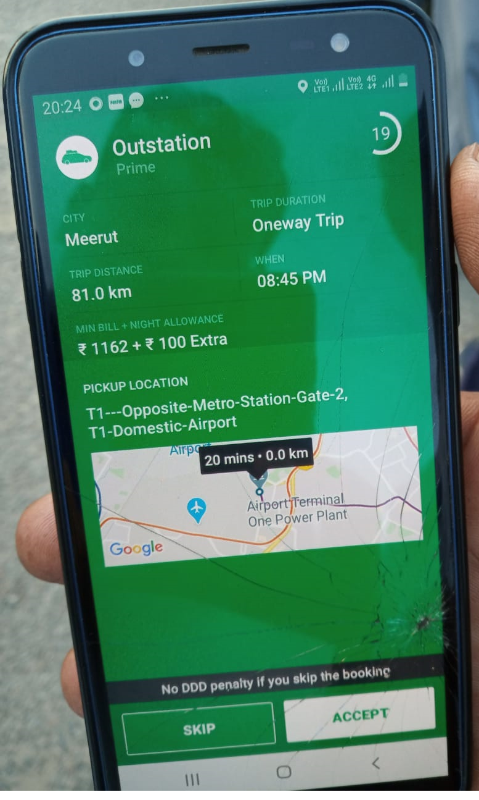
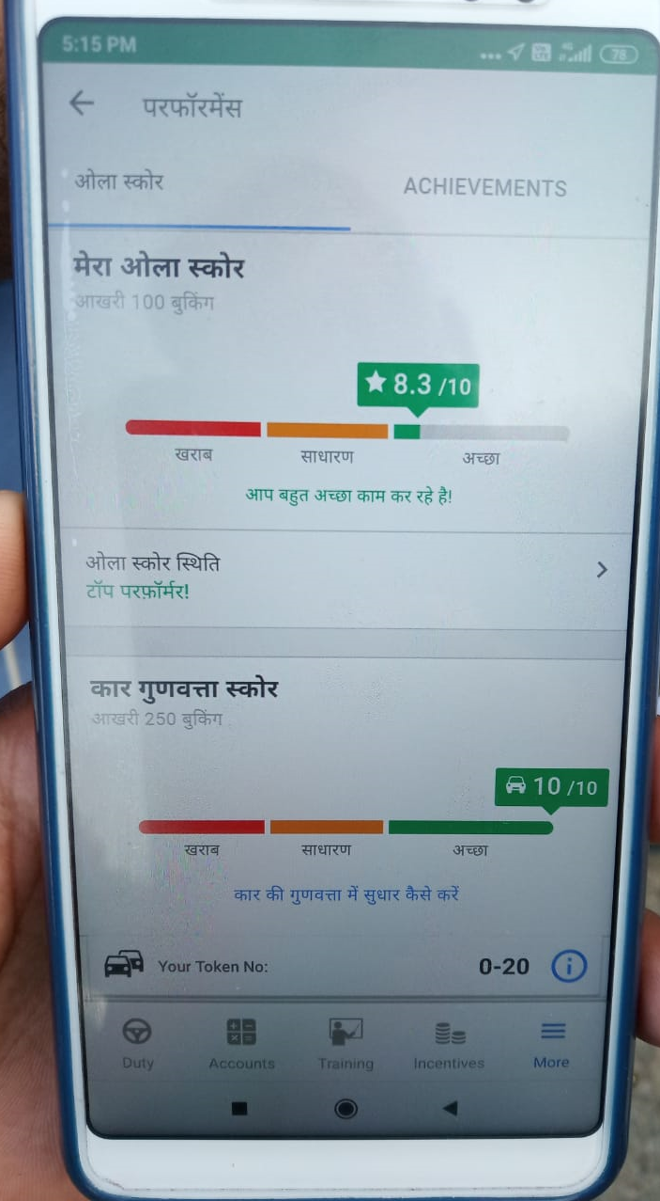
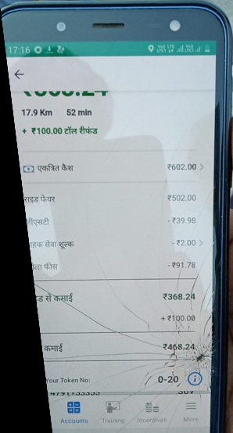
SNAPS OF APPLICATION
Outstation rides- not
penalised for refusing
Driver rating OLA
OLA Deduction
SIL 861 - UBER Algorithm Analysis
<number>

Slide 56
FINDINGS & ETHICAL ISSUES
Non Ola/Uber Taxi Drivers
Fixed cut 15 Rs per-ride
Need to be in queue for their turn
Unionization to listen to their complaints
Non Ola/Uber Salaried drivers
Employee benefit
Fixed salary
Paid leave
Safety
Job security
Insurance
Non Ola/ Uber driver are better poised and satisfied with their job as the rules of engagement are fixed and well defined
SIL 861 - UBER Algorithm Analysis
<number>
Notes:
<number>

Slide 57
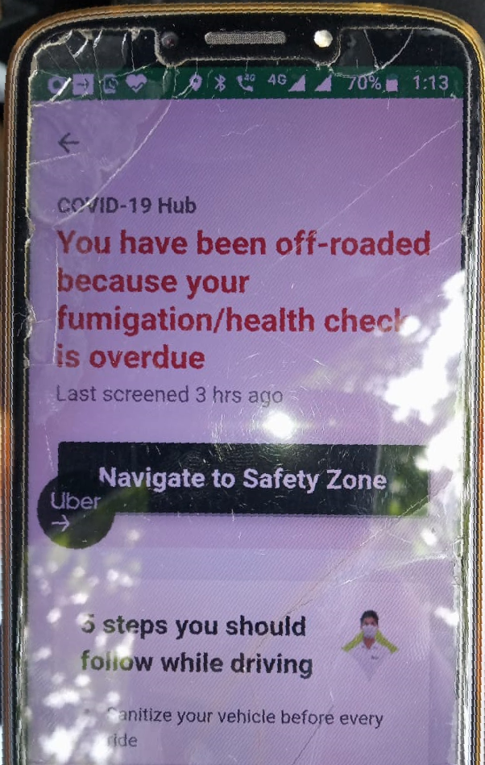
FINDINGS & ETHICAL ISSUES
Covid -19 Impact- Help to driver partners
Initial one time grant of Rs 3000 given to drivers of Uber
Loan of Rs 1500 given which drivers have to weekly reimburse
Business is very low and drivers finding difficult to survive
Sanitizers provided to drivers and have to undergo health checkups
Health Insurance given to drivers against covid-19 when getting infected while on duty
Ola- 'Drive The Driver Fund' helped thousands of drivers and their families during the pandemic
"The company helped 55,918 families, distributed 9.3 million meals and aided 843 medical emergencies across 25 cities"
Off-Roaded
Due to health check overdue
<number>
SIL 861 - UBER Algorithm Analysis

Slide 58
FINDINGS & ETHICAL ISSUES
With ride-hailing almost coming to a stop, Ola's revenue in April and May declined by almost 95%. Uber too took a major revenue hit as the rides business had been a bigger contributor
Ola Co-founder & CEO, Bhavish Aggarwal, in May told the employees that the company would have to reduce the staff strength by 1,400
Uber India decision to lay off around 600 full-time employees due to the impact of the corona virus crisis
How to decide whom to layoff not disclosed by Cab companies
Based on Kantian theory it is unethical to Layoff employees as it will severely impact their wellbeing It will be very difficult to find new jobs in covid -19 period
Considering Circumstantial theory of ethics company has not much choice other than to lay off employees, other wise if company shuts all employees will loose jobs
SIL 861 - UBER Algorithm Analysis
<number>

Slide 59
CONCLUSION
Uber did not follow participatory design principles in its App or business model. This caused multiple grey areas, which result in a driver’s dissatisfaction.
It seems to be done purposefully to support the companies’ high profit-making policies
Neglected the drivers and treat them as humanoids.
In UK now drivers have been given a chance to view the algorithm
It may bring change in how the gig economy shapes up in the future.
SIL 861 - UBER Algorithm Analysis
<number>

Slide 60
CONCLUSION
Drivers have long exhausting working hours around 12 to 18 hours a day and very little is thought about drivers health
Company is almighty, can suspend driver anytime for meagre reasons
92% drivers believe their earning have increase by better organising the jobs, but worker exploitation is immense
High percentage of drivers express distrust in company policy but still want to continue with company due to lack of effective competition, as Ola and Uber combined account for >90% of market share
There are not many legal rights when it comes to drivers and even their education level is low
Drivers are not aware about there rights or they don't have any. They don’t have any legal framework to express their grieve and Law is yet to catch up to gig economy
SIL 861 - UBER Algorithm Analysis
<number>
Notes:
<number>

Slide 61
CONCLUSION
In India not much thought is given by drivers for to be treated as employees or independent contractors due to lack of knowledge and legal framework.
The concept of driver as an employee and their rights will slowly hold ground as the gig economy grows and awareness of drivers increase
Layoff of employees is required for survival of company and satisfies circumstantial theory of ethics, but the not defining layoff criteria is unethical
Government may have to take some concrete decisions for survival of these freelance drivers in gig economy
Post pandemic era will reshape the gig economy and give new definition to driver partner and company relationship
SIL 861 - UBER Algorithm Analysis
<number>
Notes:
<number>

Slide 62
BIBLIOGRAPHY
The Truth About How Uber’s App Manages Drivers Alex Rosenblat
Biz Model for Uber Technologies Inc.
A REAL-TIME RIDESHARING SERVICE - AMBRE FISCHER | ARNAUD LEGRIS | CHRISTOPHER LAURENTIUS | JOYCE LIM | KEONG PEI QUAN | RAYMOND UNG
Algorithmic Labor and Information Asymmetries: A Case Study of Uber’s Drivers ALEX ROSENBLAT and LUKE STARK
Optimizing a dispatch system using an AI simulation framework - Voytek
https://newsroom.uber.com/semi-automated-science-using-an-ai-simulation-framework/
How Uber Uses Data to Improve Their Service and Create the New Wave of Mobility https://neilpatel.com/blog/how-uber-uses-data
SIL 861 - UBER Algorithm Analysis
<number>

Slide 63
REFERENCES
https://inc42.com/buzz/uber-india-brings-ads-on-cars-to-increase-driver-income/
https://www.thehindubusinessline.com/news/national/uber-india-national-fuel-price-index-to-boost-drivers-income/article25503927.ece
https://www.who.com.au/uber-passenger-rating-is-yours-good-bad-or-average
Ola, Uber drivers don’t earn as much as you think they do
S Prabhakaran January 10, 2017
https://www.indeed.co.in/cmp/Uber/salaries
https://www.glassdoor.co.in/Reviews/Uber-Reviews-E575263.htm
https://www.medianama.com/2016/12/223-uber-fleet-launch-india/
SIL 861 - UBER Algorithm Analysis
<number>

Slide 64
REFERENCES
https://www.deccanherald.com/business/business-news/ola-extends-help-to-over-55k-families-of-its-driving-partners-during-pandemic-865233.html
https://yourstory.com/2020/07/ola-foundation-enables-one-crore-meals-to-driver-partners-families
https://tech.economictimes.indiatimes.com/news/mobile/how-the-pandemic-has-hit-ola-uber-hard-in-india/76956369
SIL 861 - UBER Algorithm Analysis
<number>

